Slide 1

Java OOP
Course Introduction
SoftUni Team
Technical Trainers
Software University
https://softuni.bg/

Slide 2
Table of Contents
Diamond Partners
Course Objectives & Program
The Trainers Team
Course Organization
Homework
Exam
Resources

Slide 3











SoftUni Diamond Partners

Slide 4



Educational Partners

Slide 5

Course Objectives

Slide 6
Why OOP?
Object-oriented programming is an important paradigm
Anyone involved in software development should be familiar with OOP and OO modelling
All modern languages are either object-oriented or support classes and objects
Modern frameworks, libraries and APIs are object-oriented
OOP is a basic requirement for starting a job as developer
6

Slide 7
Course Topics
Working with Abstraction
Encapsulation
Inheritance
Interfaces and Abstraction
Polymorphism
SOLID
Reflection and Annotations
Workshop: Exceptions and Error Handling
Unit Testing
Test Driven Development
Design Patterns

Slide 8

The Trainers Team

Slide 9
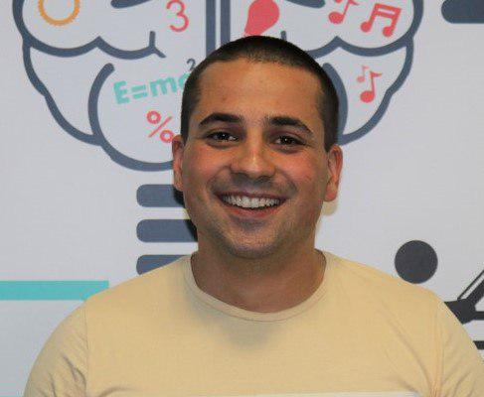
Martin Paunov
Java Developer at Virtual Racing School
Experience with Java, C++, C#
Technical Trainer @ SoftUni
Interested in Astrophysics

Slide 10
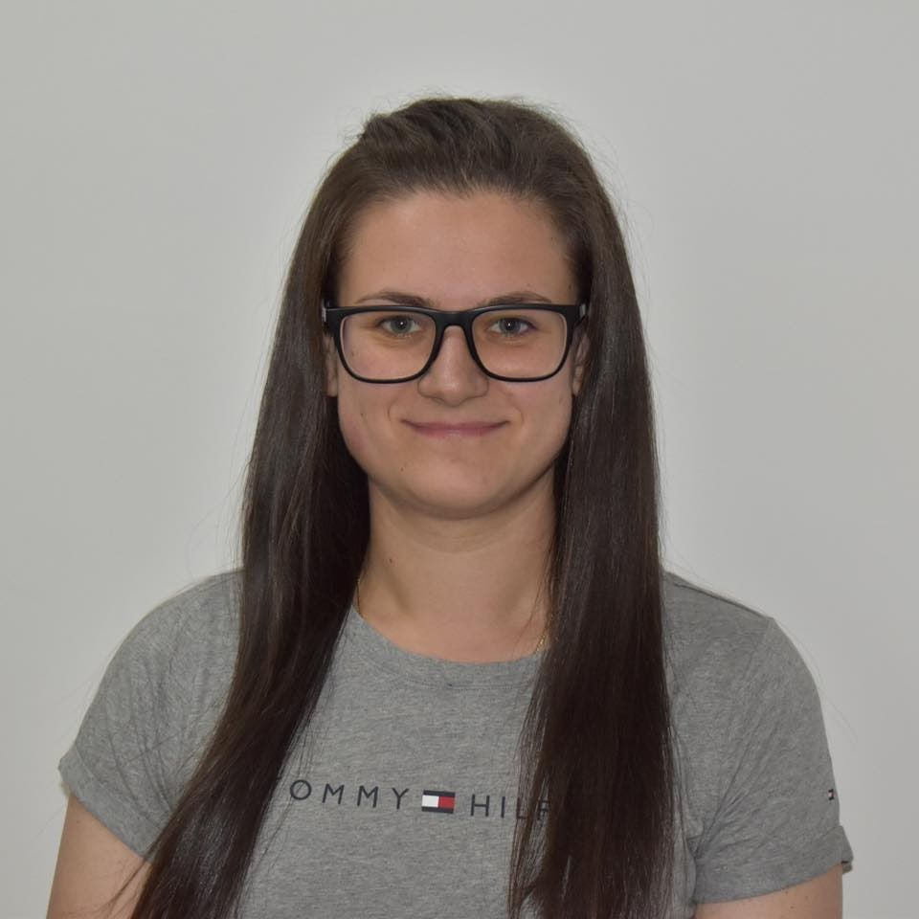
Desislava Topuzakova
Java Developer @ SAP
Ex-Competitor with Mathematics
Technical Trainer @ SoftUni
Programming Basics Team Lead
Content Development Team Lead @ SoftUni

Slide 11

Course Organization

Slide 12
Course Information
7 weeks / 4 times a week
15 Credits
Time frame
28 June 2021 – 15 August 2021
Exams
Theoretical: 15 August 2021
Practical: 15 August 2021
Theoretical (Retake): 22 August 2021
Practical (Retake): 22 August 2021
12

Slide 13

Homework Assignments & Exercises
Your homework is mainly work in class
Lesson days → slides + live demos + exercises
Exercise days → only exercises
How to submit your homework?
Submitted in the judge system
Do your homework when it's due
Assignments pile up quickly

Slide 14


SoftUni Certificate
PracticalExam 100%
Evaluation
Homework 5 %
14

Slide 15

CPE Certificate
Practical Exam
Theoretical Exam
Evaluation
15

Slide 16
Practical Exam
2 practical problem for 4 hours
Create a simple project
Following the OOP principles
Implement functionality based on the description
Test a provided class
Automated judge system with real-time feedback
Upload a zip project to the judge system
16

Slide 17
Theoretical Exam
30 minutes
Multiple-choice with 1 or more correct answer
English
Automated quiz system
Available online on the day of the practical exam
You can submit your answers just one time
17

Slide 18

Resources

Slide 19



Course Web Site, Forum and FB Group
Official web site:
Official discussion forum:
Official Facebook groups:
Community Facebook group:
https://softuni.bg/trainings/3346/java-oop-june-2021
https://softuni.bg/forum/categories/69/module-java-advanced
https://www.facebook.com/groups/javaadvancedmay2021
https://www.facebook.com/groups/SoftUniJavaCommunity/

Slide 20


Learn to Search in Internet
The course assignments require to search in Internet
This is an important part of the learning process
Some exercises intentionally have no hints
Learn to find solutions!
Software development includes everyday searching and learning
No excuses, just learn to study!
Developers learn new technologies, tools, languages every day!

Slide 21
Trainings @ Software University (SoftUni)
Software University – High-Quality Education, Profession and Job for Software Developers
softuni.bg
Software University Foundation
softuni.foundation
Software University @ Facebook
facebook.com/SoftwareUniversity
Software University Forums
forum.softuni.bg
21
Notes:
21

Slide 22

License
This course (slides, examples, demos, exercises, homework, documents, videos and other assets) is copyrighted content
Unauthorized copy, reproduction or use is illegal
© SoftUni – https://about.softuni.bg
© Software University – https://softuni.bg
Notes:
22

